Slide 1
Games
2013

Slide 2
Overview of New Titles
What Goes Where
Configuration Sizes
Categories
Featured Game Play
What’s Hot
Monopoly Update

Slide 3
New Games
133 new game titles in total
Not all new titles go in all stores
Why is that?

Slide 4
New Games
Some new games are easy to identify as an all store buy – hot license, unusual concept, etc.
Other factors include title and packaging, or an extension of an already hot selling game
Some games are “tested” by being placed into the larger configurations to see how they do and will be evaluated at the end of the season

Slide 5
Configurations
CC+ and Small Inline – 292 Titles
More 10 x 10 this year – 81 more titles than CC+
New 10 x 14 (same size as 10 x 16 just no POS) – 84 more titles

Slide 6
Game Categories
Rank | Category | Percentage of Sales
1 | Party | 23.56%
2 | Cards & Dice | 15.28%
3 | Jigsaw Puzzles | 12.40%
4 | Family | 12.32%
5 | Mind Bogglers | 12.10%

Slide 7
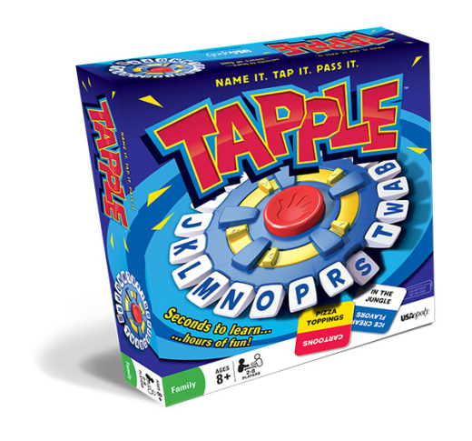
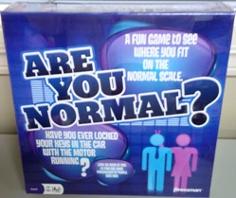
Game Play
Tapple – Seconds to Learn..Hours of Fun!
Are You Normal? – A Fun Game to See Where You Fit on the Normal Scale

Slide 8
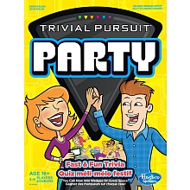
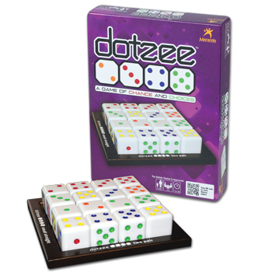
Game Play
Trivial Pursuit Party – Fast and Fun Trivia
Dotzee – A Game of Chance and Choices

Slide 9
Licenses and Themes
Big Bang Theory
Bacon
Zombies
Adventure Time
Doctor Who

Slide 10
“Retrofit”
Seeing a resurgence in classic games
Booby Trap
Rockem’ Sockem’ Robots
Bed Bugs
Magic 8 Ball

Slide 11
Monopoly Tip
The monopoly end will have a slightly different
look this season depending on the store size.
This will help keep them from falling off
when placed on towers in kiosks.

Slide 12
Recap
133 New Titles!
Some in all stores, some are tests
Increases sizes should = increased $$
Top 5 Categories
Party
Cards & Dice
Jigsaw Puzzles
Family
Mind Bogglers
Hot Games
Big Bang Theory
Bacon
Zombies
Adventure Time
Retro Games
Booby Trap
Rockem’ Sockem’ Robots
Bed Bugs
Magic 8 Ball
Remember to “tip” your monopoly

